Slide 1
CSE 417T Introduction to Machine Learning
Lecture 14 Instructor: Chien-Ju (CJ) Ho

Slide 2
Logistics
Homework 3: due yesterday (Wednesday)
If you still have late days, the final due is tomorrow
Track your own late-day usages
Assignments over-using late days won’t be graded
Exam 1: October 27 (Thursday)
Topics: LFD Chapters 1 to 5
Timed exam (75 min) during lecture time
Location TBD
Closed-book exam with 2 letter-size cheat sheets allowed (4 pages in total)
No format limitations (it can be typed, written, or a combination)
October 25 (Tuesday) will be a review session
Practice questions are posted on Piazza (will be discussed during the review session)

Slide 3
Recap

Slide 4
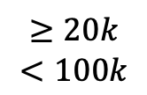
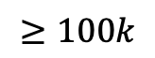
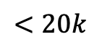
Decision Tree Hypothesis
Pros
Easy to interpret (interpretability is getting attention and is important in some domains)
Can handle multi-type data (Numerical, categorical. …)
Easy to implement (Bunch of if-else rules)
Cons
Generally speaking, bad generalization
VC dimension is infinity
High variance (small change of data leads to very different hypothesis)
Easily overfit
Why we care?
One of the classical model
Building block for other models (e.g., random forest)
Annual Income
$$≥100k$$
$$≥20k$$
$$<100k$$
$$<20k$$
Approve
have debt?
Deny
Deny
yes
no
Deny
Deny
Approve
Approve
Credit Card Approval Example

Slide 5
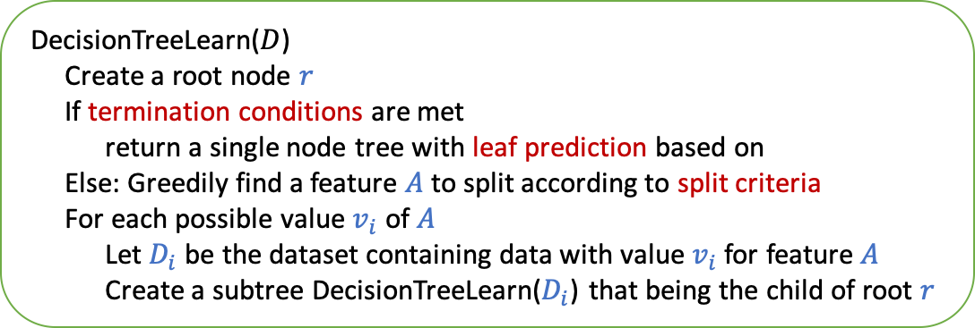
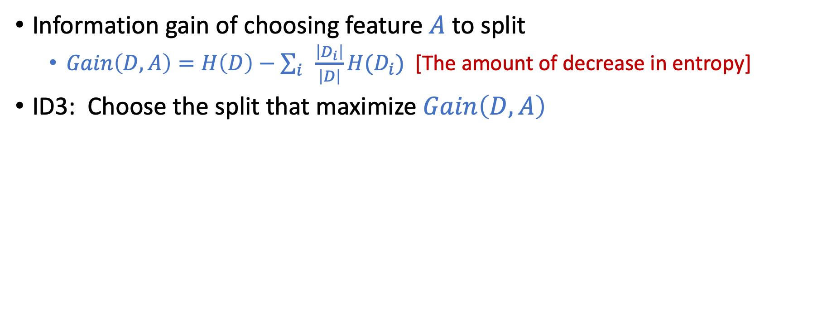
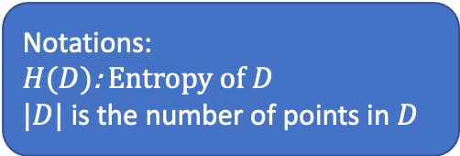
ID3: Using Information Gain as Selection Criteria
Information gain of choosing feature $A$ to split
$Gain\left(D,A\right)=H\left(D\right)−\sum_{i}{\frac{\left|D_{i}\right|}{\left|D\right|}}H(D_{i})$ [The amount of decrease in entropy]
ID3: Choose the split that maximize $Gain\left(D,A\right)$
Notations:
$H(D)$: Entropy of $D$
$|D|$ is the number of points in $D$
DecisionTreeLearn($D$)
Create a root node $r$
If termination conditions are met
return a single node tree with leaf prediction based on
Else: Greedily find a feature $A$ to split according to split criteria
For each possible value $v_{i}$ of $A$
Let $D_{i}$ be the dataset containing data with value $v_{i}$ for feature $A$
Create a subtree DecisionTreeLearn($D_{i}$) that being the child of root $r$
ID3 termination conditions
If all labels are the same
If all features are the same
If dataset is empty
ID3 leaf predictions
Most common labels (majority voting)
ID3 split criteria
Information gain

Slide 6
Ensemble Learning
Goal: Utilize a set of weak learners to obtain a strong learner.
One common way to construct weak learners is via decision trees
Fully grown decision trees
High variance
Low bias
Decision stump (One-depth decision trees, split on only one attribute)
Low variance
High bias

Slide 7
Ensemble Learning
Goal: Utilize a set of weak learners to obtain a strong learner.
Format of ensemble learning
Construct many diverse weak learners
Aggregate the weak learners
Bagging
Construct diverse weak learners
(Simultaneously) bootstrap datasets
Train weak learners on them
Aggregate the weak learners
Uniform aggregation

Slide 8
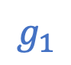
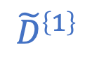

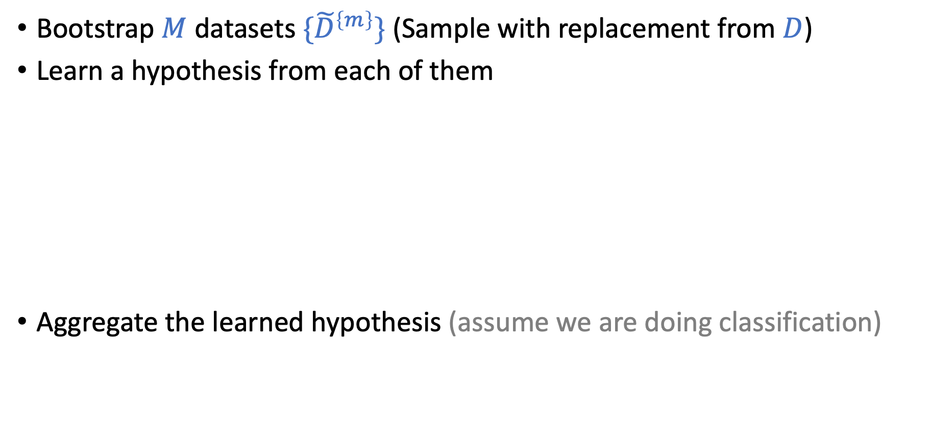

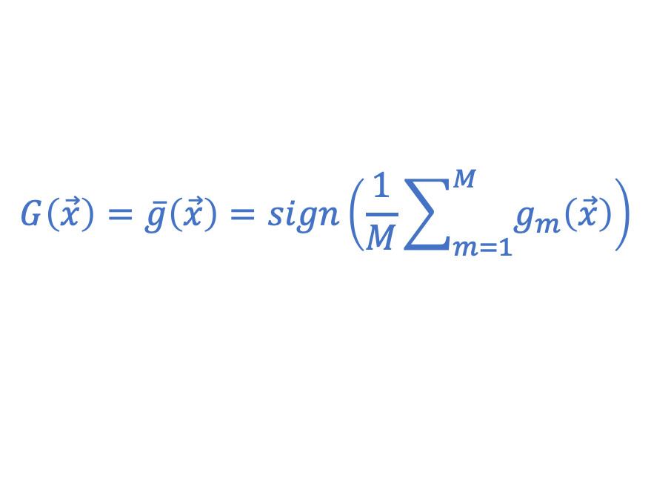
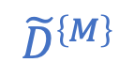
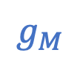
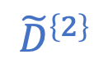
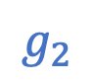
Bagging - Bootstrapped Aggregating
Bootstrap $M$ datasets ${\{\tilde{D}}^{\left\{m\right\}}\}$(Sample with replacement from $D$)
Learn a hypothesis from each of them
Aggregate the learned hypothesis (assume we are doing classification)
$${\tilde{D}}^{\left\{1\right\}}$$
$$g_{1}$$
$${\tilde{D}}^{\left\{2\right\}}$$
$$g_{2}$$
$$H$$
$$…$$
$${\tilde{D}}^{\left\{M\right\}}$$
$$g_{M}$$
$$G\left(\vec{x}\right)=\overline{g}\left(\vec{x}\right)=sign\left(\frac{1}{M}\sum_{m=1}^{M}{g_{m}\left(\vec{x}\right)}\right)$$

Slide 9
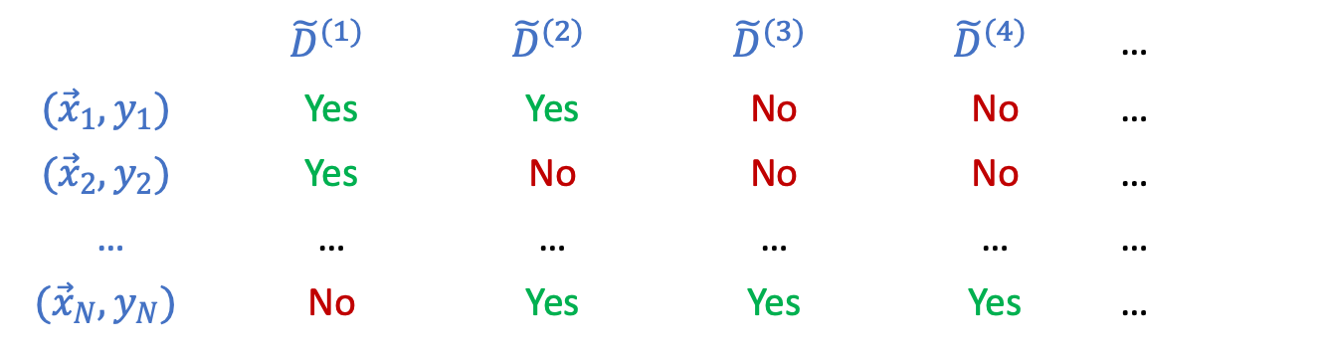
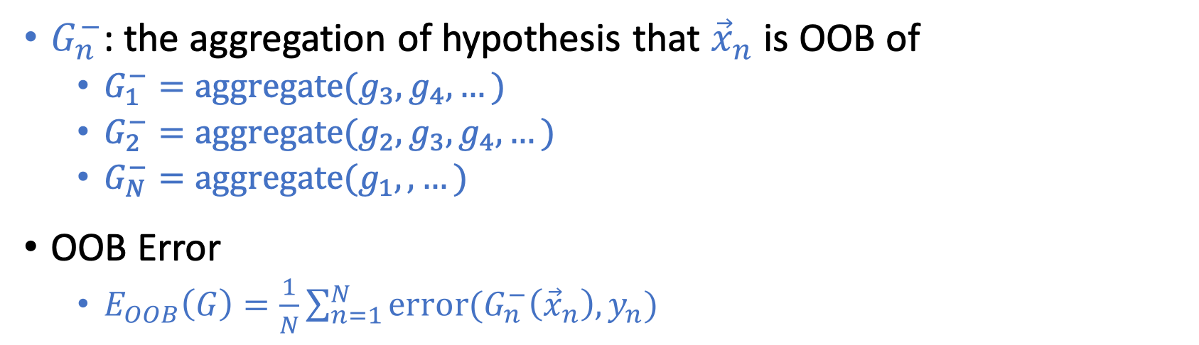
Out-Of-Bag (OOB) Error
 | $${\tilde{D}}^{(1)}$$ | $${\tilde{D}}^{(2)}$$ | $${\tilde{D}}^{(3)}$$ | $${\tilde{D}}^{(4)}$$ | …
$${(\vec{x}}_{1},y_{1})$$ | Yes | Yes | No | No | …
$${(\vec{x}}_{2},y_{2})$$ | Yes | No | No | No | …
… | … | … | … | … | …
$${(\vec{x}}_{N},y_{N})$$ | No | Yes | Yes | Yes | …
Whether a point is in a bootstrapped dataset
$G_{n}^{−}$: the aggregation of hypothesis that ${\vec{x}}_{n}$ is OOB of
$G_{1}^{−}=\text{aggregate}(g_{3},g_{4},…)$
$G_{2}^{−}=\text{aggregate}(g_{2},g_{3},g_{4},…)$
$G_{N}^{−}=\text{aggregate}(g_{1},,…)$
OOB Error
$E_{OOB}\left(G\right)=\frac{1}{N}\sum_{n=1}^{N}{\text{error}(G_{n}^{−}\left({\vec{x}}_{n}\right),y_{n})}$
Aggregate:
Majority voting for classification
Average for regression
Error:
Binary error for classification
Squared error for regression

Slide 10
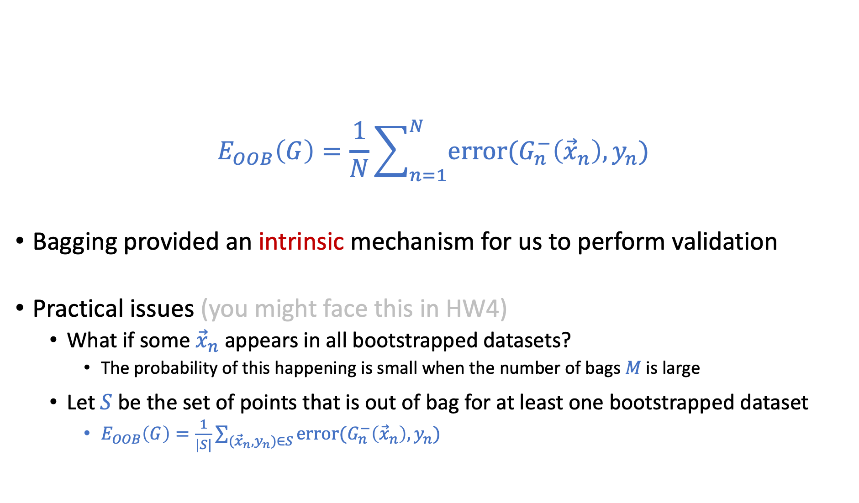
Out-Of-Bag (OOB) Error
$$E_{OOB}\left(G\right)=\frac{1}{N}\sum_{n=1}^{N}{\text{error}(G_{n}^{−}\left({\vec{x}}_{n}\right),y_{n})}$$
Bagging provided an intrinsic mechanism for us to perform validation
Practical issues (you might face this in HW4)
What if some ${\vec{x}}_{n}$ appears in all bootstrapped datasets?
The probability of this happening is small when the number of bags $M$ is large
Let $S$ be the set of points that is out of bag for at least one bootstrapped dataset
$E_{OOB}\left(G\right)=\frac{1}{|S|}\sum_{({\vec{x}}_{n},y_{n})∈S}{\text{error}(G_{n}^{−}\left({\vec{x}}_{n}\right),y_{n})}$

Slide 11
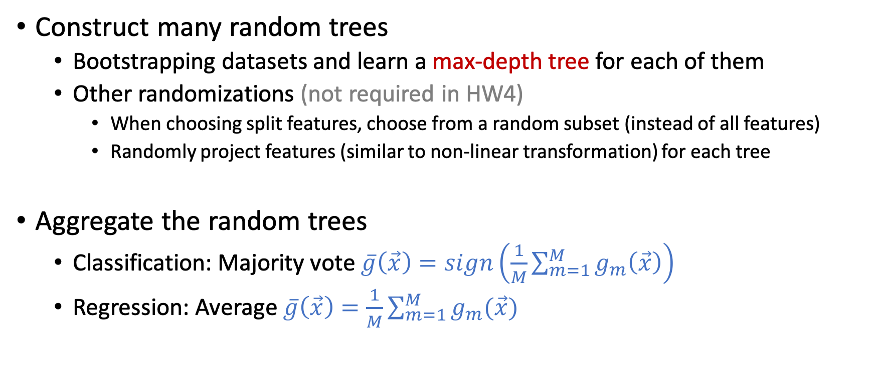
Random Forest
Construct many random trees
Bootstrapping datasets and learn a max-depth tree for each of them
Other randomizations (not required in HW4)
When choosing split features, choose from a random subset (instead of all features)
Randomly project features (similar to non-linear transformation) for each tree
Aggregate the random trees
Classification: Majority vote $\overline{g}\left(\vec{x}\right)=sign\left(\frac{1}{M}\sum_{m=1}^{M}{g_{m}\left(\vec{x}\right)}\right)$
Regression: Average $\overline{g}\left(\vec{x}\right)=\frac{1}{M}\sum_{m=1}^{M}{g_{m}(\vec{x})}$

Slide 12
Today’s Lecture
The notes are not intended to be comprehensive. They should be accompanied by lectures and/or textbook.
Let me know if you spot errors.

Slide 13
Boosting

Slide 14
Ensemble Learning
Goal: Utilize a set of weak learners to obtain a strong learner.
Format of ensemble learning
Construct many diverse weak learners
Aggregate the weak learners
Bagging:
Construct diverse weak learners
(Simultaneously) bootstrapping datasets
Train weak learners on them
Aggregate the weak learners
Uniform aggregation
Boosting
Construct diverse weak learners
Adaptively generating datasets
Train weak learners on them
Aggregate the weak learners
Weighted aggregation

Slide 15
Informal Intuitions about Boosting
Example : Teach a class of kids to identify apples from data
Alice: Apples are circular
Teacher: Circular is a good feature, but using this feature might make some mistakes
Let me highlight the mistakes.
Make correct images smaller
Make incorrect images larger
Apples
Not
Apples
Example created by Hsuan-Tien Lin

Slide 16
Informal Intuitions about Boosting
Example : Teach a class of kids to identify apples from data
Alice: Apples are circular
Bob: Apples are red
Teacher: Yes, many apples are red but it could still make mistakes. Let me highlight the mistakes.
Make correct images smaller
Make incorrect images larger
Example created by Hsuan-Tien Lin

Slide 17
Informal Intuitions about Boosting
Example : Teach a class of kids to identify apples from data
Alice: Apples are circular
Bob: Apples are red
Charlie: Apples could be green
Example created by Hsuan-Tien Lin

Slide 18
Informal Intuitions about Boosting
Example : Teach a class of kids to identify apples from data
Alice: Apples are circular
Bob: Apples are red
Charlie: Apples could be green
David: Apples have stems at the top
Class: Apples are somewhat circular, somewhat red, possibly green, and may have stems at the top
Example created by Hsuan-Tien Lin

Slide 19
Informal Intuitions about Boosting
Example : Teach a class of kids to identify apples from data
Alice: Apples are circular
Bob: Apples are red
Charlie: Apples could be green
David: Apples have stems at the top
Class: Apples are somewhat circular, somewhat red, possibly green, and may have stems at the top
Key steps of this process:
Learn a simple hypothesis for each dataset
Iteratively update the dataset to focus on what we got wrong (i.e., create diversity)
Aggregate the learned simple hypothesis
Example created by Hsuan-Tien Lin

Slide 20
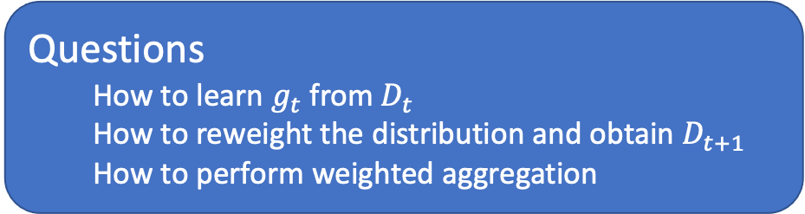
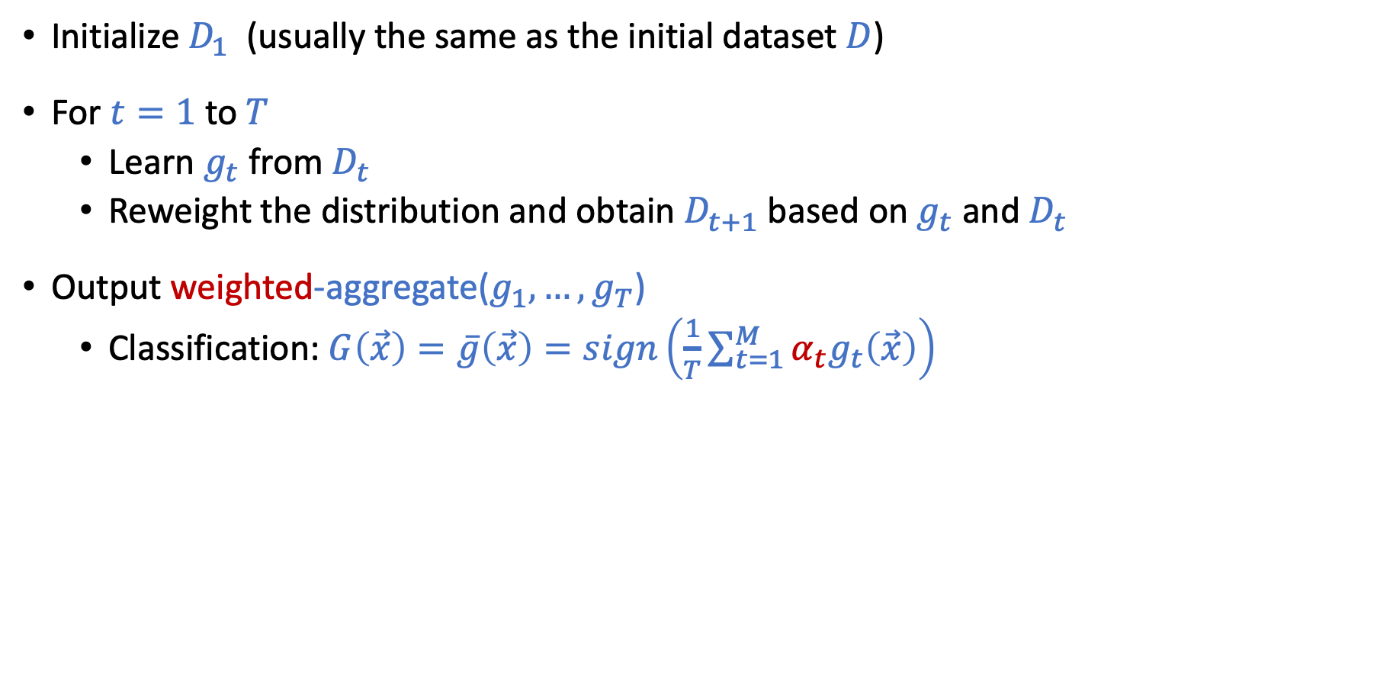
Outline of a Boosting Algorithm
Initialize $D_{1}$ (usually the same as the initial dataset $D$)
For $t=1$ to$T$
Learn $g_{t}$ from $D_{t}$
Reweight the distribution and obtain $D_{t+1}$ based on $g_{t}$ and $D_{t}$
Output weighted-aggregate($g_{1},…,g_{T}$)
Classification: $G\left(\vec{x}\right)=\overline{g}\left(\vec{x}\right)=sign\left(\frac{1}{T}\sum_{t=1}^{M}{α_{t}g_{t}\left(\vec{x}\right)}\right)$
Questions
How to learn $g_{t}$ from $D_{t}$
How to reweight the distribution and obtain $D_{t+1}$
How to perform weighted aggregation

Slide 21
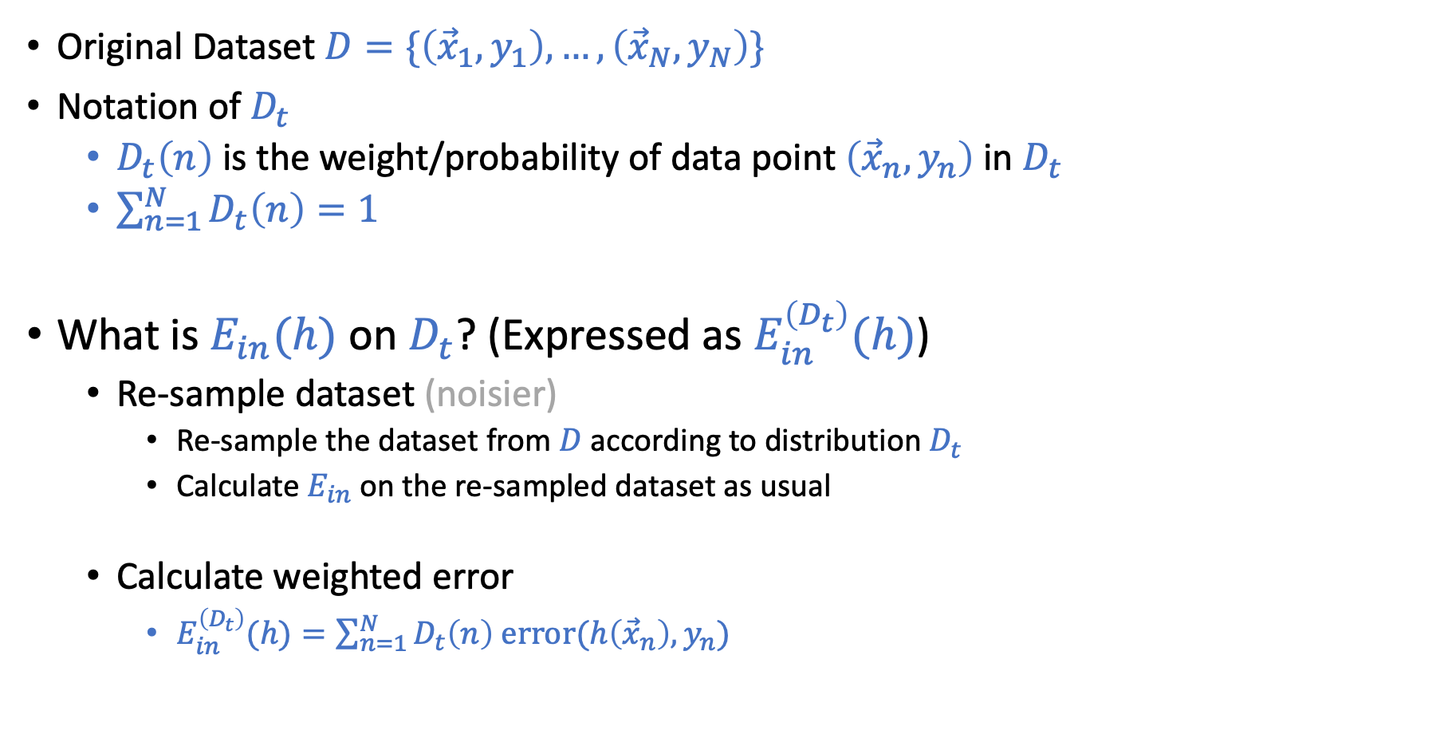
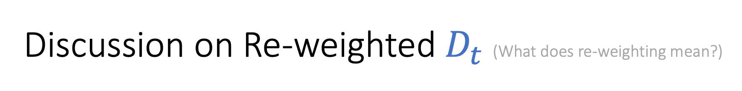
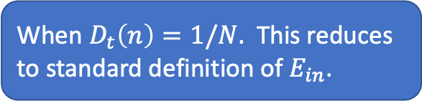
Discussion on Re-weighted $D_{t}$ (What does re-weighting mean?)
Original Dataset $D=\{\left({\vec{x}}_{1},y_{1}\right),…,\left({\vec{x}}_{N}, y_{N}\right)\}$
Notation of $D_{t}$
$D_{t}\left(n\right)$ is the weight/probability of data point $\left({\vec{x}}_{n},y_{n}\right)$ in $D_{t}$
$\sum_{n=1}^{N}{D_{t}\left(n\right)=1}$
What is $E_{in}(h)$ on $D_{t}$? (Expressed as $E_{in}^{\left(D_{t}\right)}(h)$)
Re-sample dataset (noisier)
Re-sample the dataset from $D$ according to distribution $D_{t}$
Calculate $E_{in}$ on the re-sampled dataset as usual
Calculate weighted error
$E_{in}^{\left(D_{t}\right)}(h)=\sum_{n=1}^{N}{D_{t}\left(n\right) \text{error}(h\left({\vec{x}}_{n}\right),y_{n})}$
When $D_{t}\left(n\right)=1/N.$ This reduces to standard definition of $E_{in}$.

Slide 22
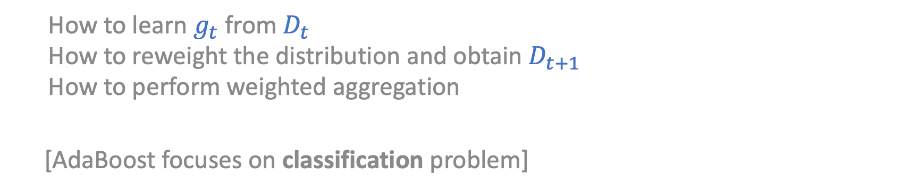
AdaBoost – Adaptive Boosting
How to learn $g_{t}$ from $D_{t}$
How to reweight the distribution and obtain $D_{t+1}$
How to perform weighted aggregation
[AdaBoost focuses on classification problem]

Slide 23
Boosting Background
A theoretical question asked by Kearns and Valiant
Whether a “weak” learning algorithm which performs just slightly better than random guessing in the PAC model can be “boosted” into an arbitrarily accurate “strong” learning algorithm
AdaBoost
The first adaptive boosting algorithm that
has nice theoretical guarantees
successfully deployed in real-world applications

Slide 24
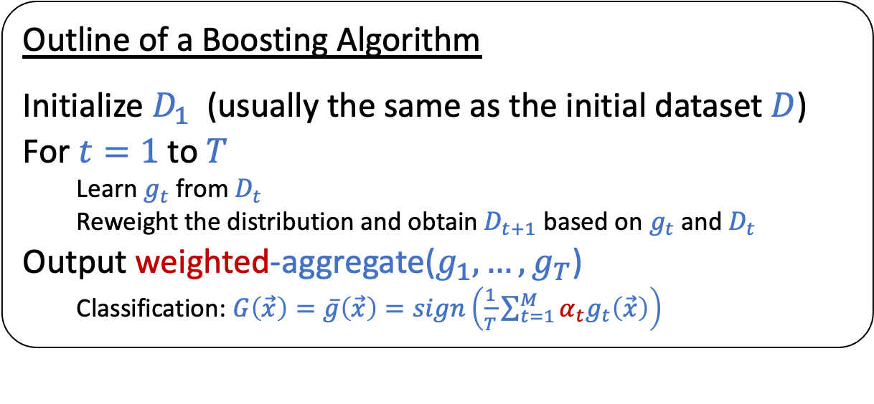
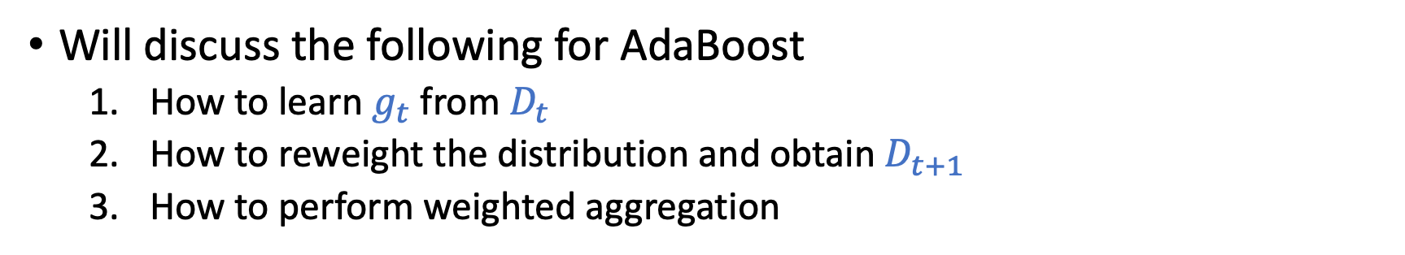
What Does AdaBoost Do?
Outline of a Boosting Algorithm
Initialize $D_{1}$ (usually the same as the initial dataset $D$)
For $t=1$ to$T$
Learn $g_{t}$ from $D_{t}$
Reweight the distribution and obtain $D_{t+1}$ based on $g_{t}$ and $D_{t}$
Output weighted-aggregate($g_{1},…,g_{T}$)
Classification: $G\left(\vec{x}\right)=\overline{g}\left(\vec{x}\right)=sign\left(\frac{1}{T}\sum_{t=1}^{M}{α_{t}g_{t}\left(\vec{x}\right)}\right)$
Will discuss the following for AdaBoost
How to learn $g_{t}$ from $D_{t}$
How to reweight the distribution and obtain $D_{t+1}$
How to perform weighted aggregation

Slide 25
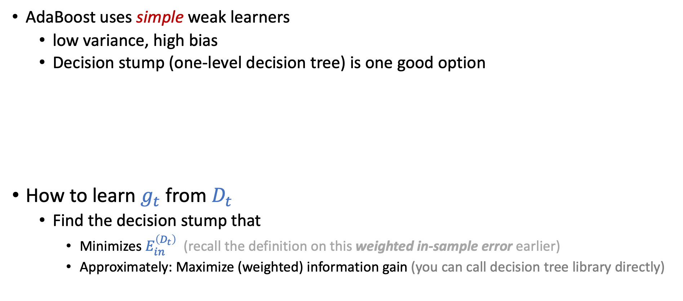
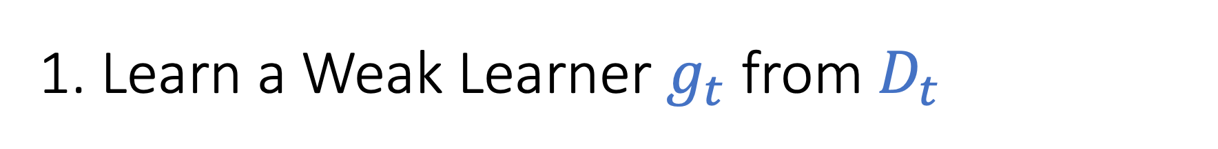
1. Learn a Weak Learner $g_{t}$ from $D_{t}$
AdaBoost uses simple weak learners
low variance, high bias
Decision stump (one-level decision tree) is one good option
How to learn $g_{t}$ from $D_{t}$
Find the decision stump that
Minimizes $E_{in}^{\left(D_{t}\right)}$ (recall the definition on this weighted in-sample error earlier)
Approximately: Maximize (weighted) information gain (you can call decision tree library directly)

Slide 26
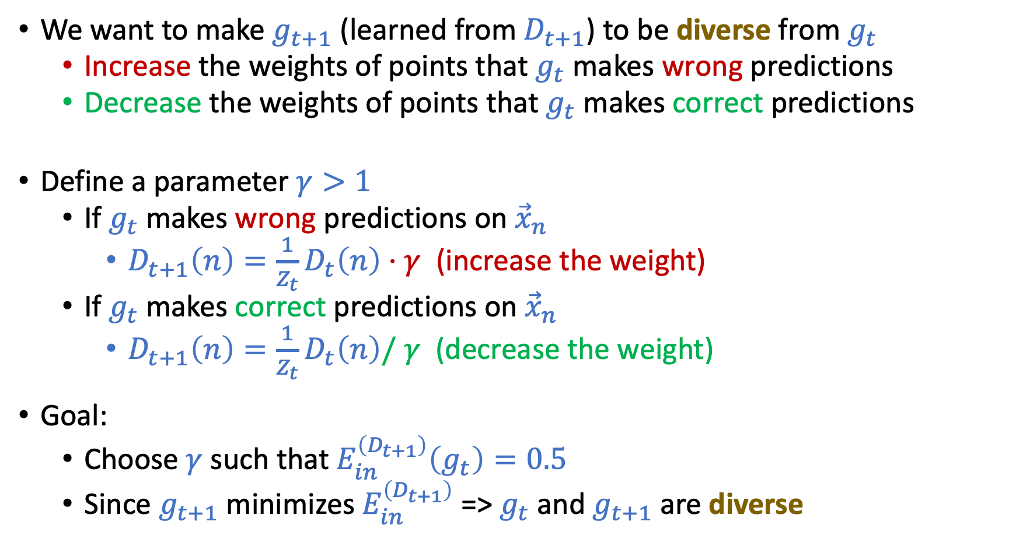
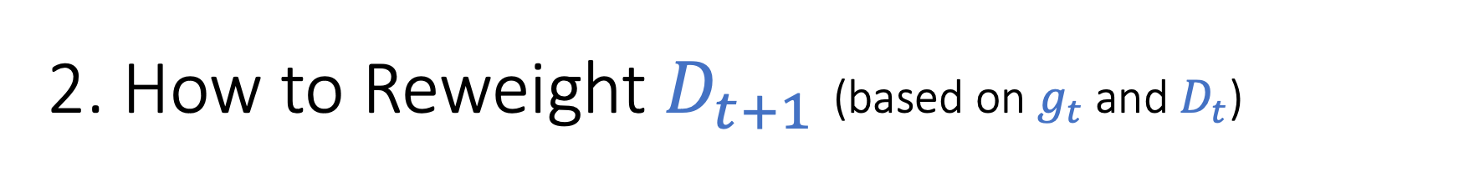
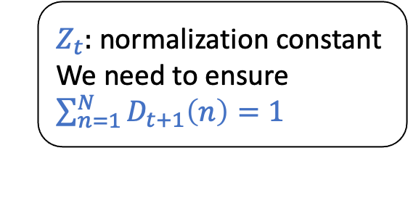
2. How to Reweight $D_{t+1}$ (based on $g_{t}$ and $D_{t}$)
We want to make $g_{t+1}$ (learned from $D_{t+1}$) to be diverse from $g_{t}$
Increase the weights of points that $g_{t}$ makes wrong predictions
Decrease the weights of points that $g_{t}$ makes correct predictions
Define a parameter $γ>1$
If $g_{t}$ makes wrong predictions on ${\vec{x}}_{n}$
$D_{t+1}\left(n\right)=\frac{1}{Z_{t}}D_{t}\left(n\right)⋅γ$ (increase the weight)
If $g_{t}$ makes correct predictions on ${\vec{x}}_{n}$
$D_{t+1}\left(n\right)=\frac{1}{Z_{t}}D_{t}\left(n\right)/ γ$ (decrease the weight)
Goal:
Choose $γ$ such that $E_{in}^{\left(D_{t+1}\right)}\left(g_{t}\right)=0.5$
Since $g_{t+1}$ minimizes $E_{in}^{\left(D_{t+1}\right)}$ => $g_{t}$ and $g_{t+1}$ are diverse
$Z_{t}:$ normalization constant
We need to ensure $\sum_{n=1}^{N}{D_{t+1}\left(n\right)=1}$

Slide 27
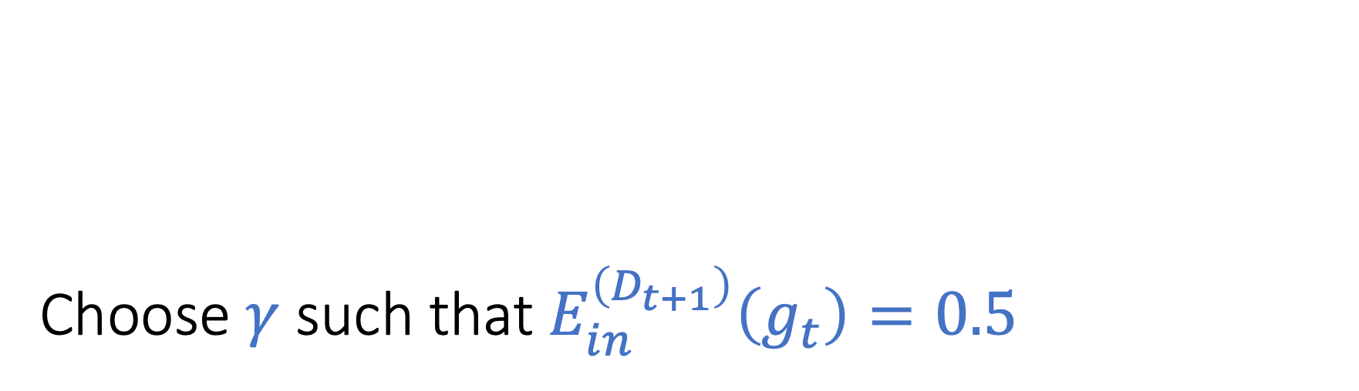
Choose $γ$ such that $E_{in}^{\left(D_{t+1}\right)}\left(g_{t}\right)=0.5$
Math derivations in the next few slides

Slide 28
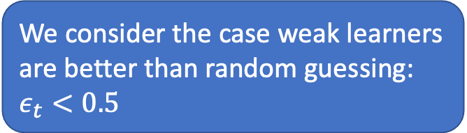
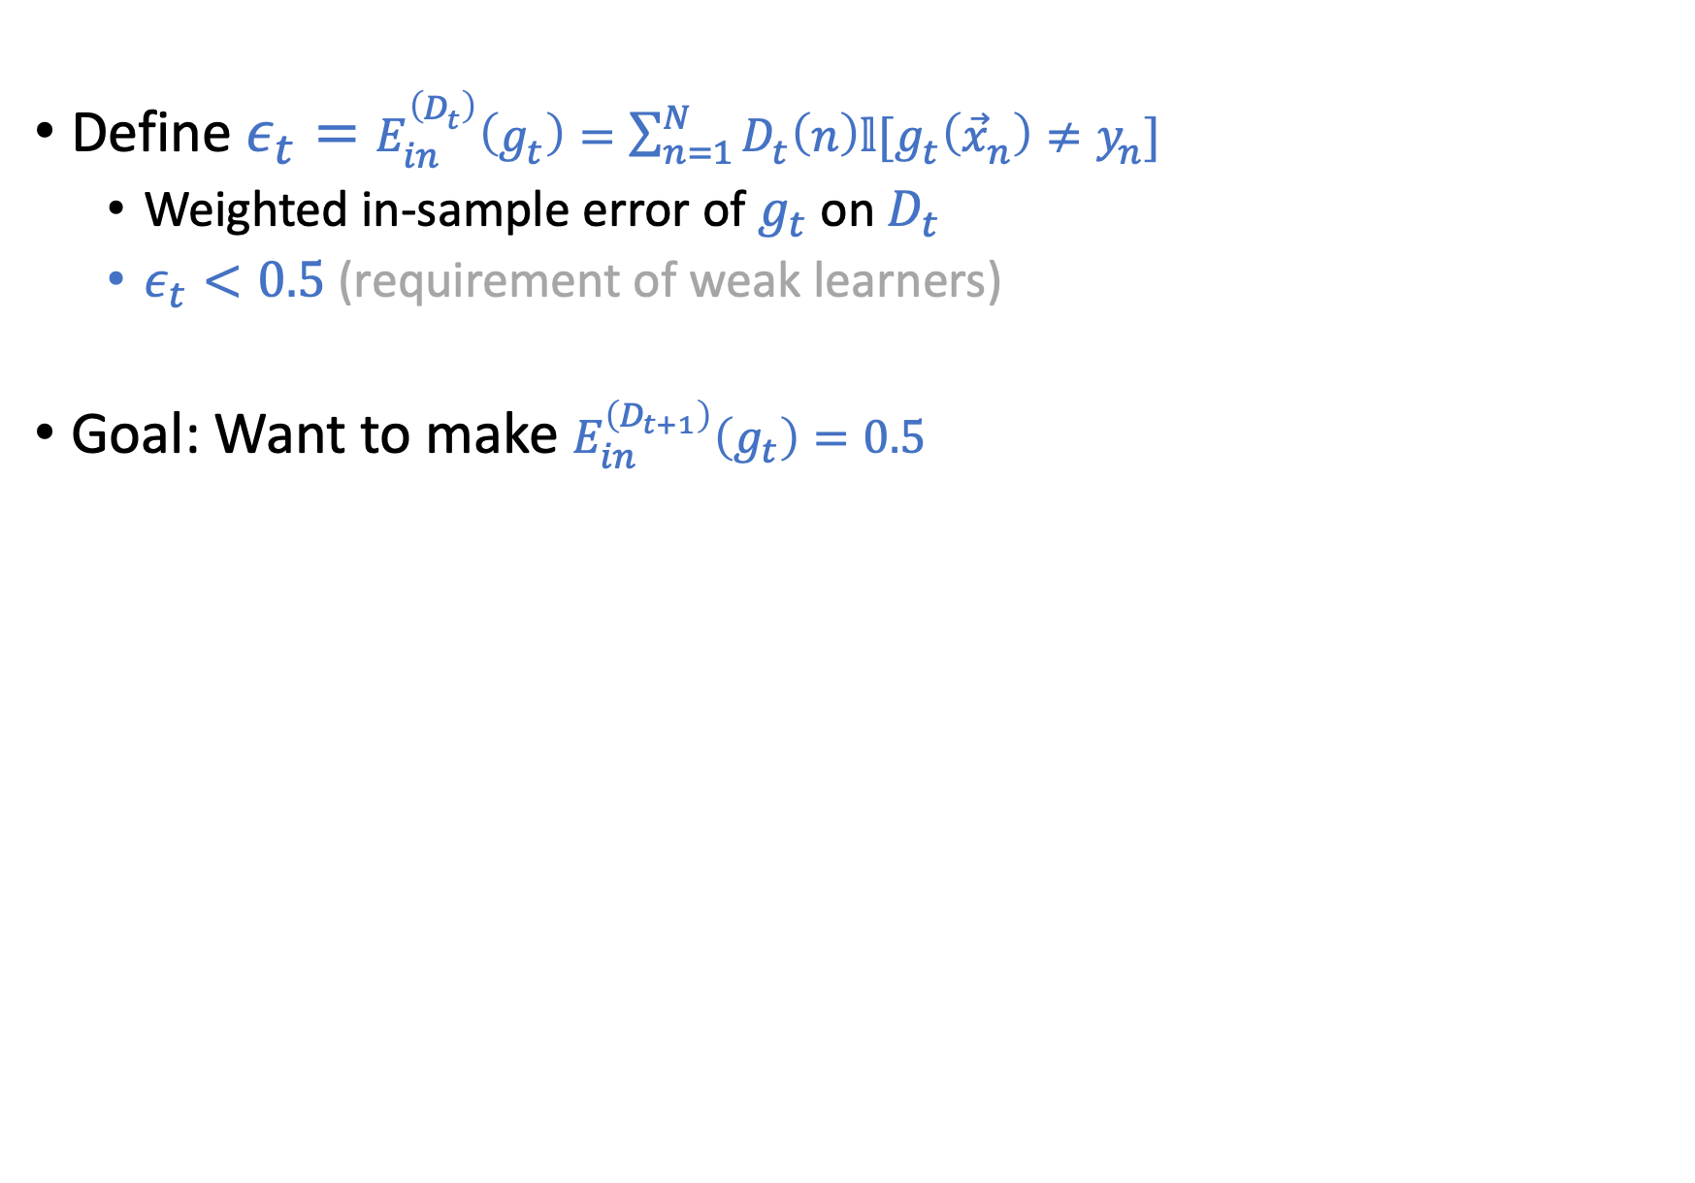
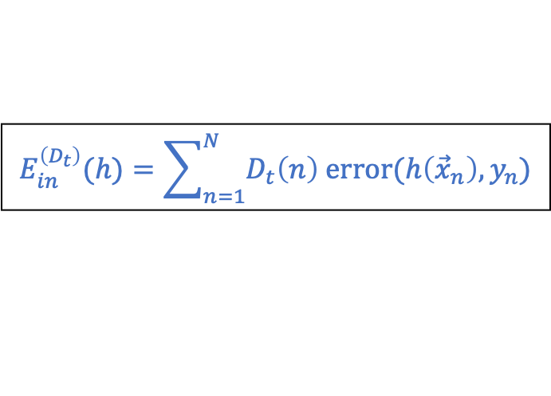
Define $ε_{t}=E_{in}^{\left(D_{t}\right)}\left(g_{t}\right)=\sum_{n=1}^{N}{D_{t}\left(n\right)𝕝[g_{t}\left({\vec{x}}_{n}\right)≠y_{n}]}$
Weighted in-sample error of $g_{t}$ on $D_{t}$
$ε_{t}<0.5$ (requirement of weak learners)
Goal: Want to make $E_{in}^{\left(D_{t+1}\right)}\left(g_{t}\right)=0.5$
$E_{in}^{\left(D_{t+1}\right)}\left(g_{t}\right)=$ $\sum_{n=1}^{N}{D_{t+1}\left(n\right)𝕝[g_{t}\left({\vec{x}}_{n}\right)≠y_{n}]}$
$E_{in}^{\left(D_{t+1}\right)}\left(g_{t}\right)=$ $\sum_{n=1}^{N}{{\frac{1}{Z_{t}}D}_{t}\left(n\right)γ 𝕝[g_{t}\left({\vec{x}}_{n}\right)≠y_{n}]}$
$E_{in}^{\left(D_{t+1}\right)}\left(g_{t}\right)=$ $\frac{γ}{Z_{t}}\sum_{n=1}^{N}{D_{t}\left(n\right) 𝕝\left[g_{t}\left({\vec{x}}_{n}\right)≠y_{n}\right]=}\frac{γ}{Z_{t}}ε_{t}$
Remember $Z_{t}=\sum_{n=1}^{N}{D_{t+1}(n)}$ is the normalization constant
$Z_{t}=$ $\sum_{n=1}^{N}{D_{t}\left(n\right)γ 𝕝[g_{t}\left({\vec{x}}_{n}\right)≠y_{n}]}+\sum_{n=1}^{N}{D_{t}\left(n\right)\frac{1}{γ} 𝕝[g_{t}\left({\vec{x}}_{n}\right)=y_{n}]}$
$Z_{t} =$ $γε_{t}+\frac{1}{γ}(1−ε_{t})$
We consider the case weak learners are better than random guessing: $ε_{t}<0.5$
$$E_{in}^{\left(D_{t}\right)}(h)=\sum_{n=1}^{N}{D_{t}\left(n\right) \text{error}(h\left({\vec{x}}_{n}\right),y_{n})}$$

Slide 29
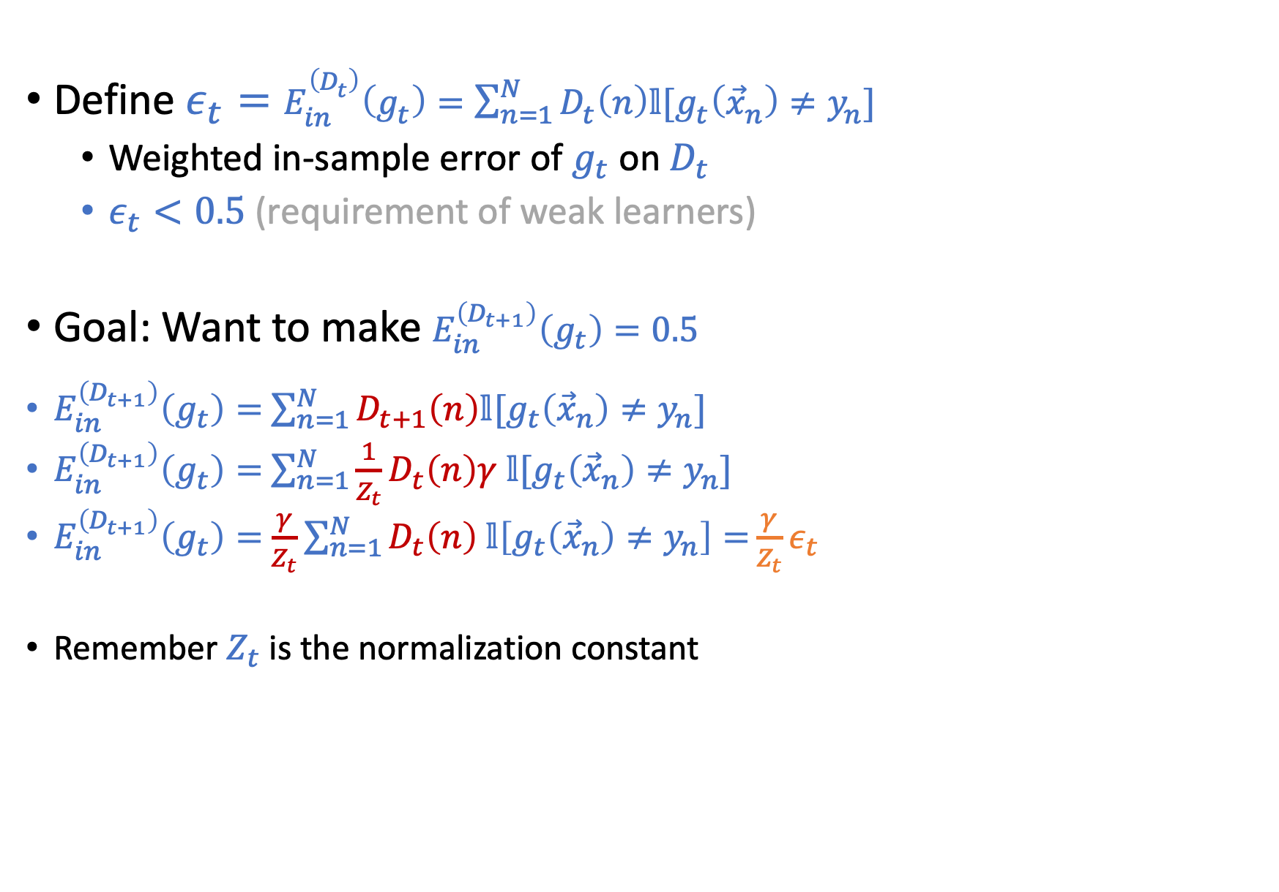
Define $ε_{t}=E_{in}^{\left(D_{t}\right)}\left(g_{t}\right)=\sum_{n=1}^{N}{D_{t}\left(n\right)𝕝[g_{t}\left({\vec{x}}_{n}\right)≠y_{n}]}$
Weighted in-sample error of $g_{t}$ on $D_{t}$
$ε_{t}<0.5$ (requirement of weak learners)
Goal: Want to make $E_{in}^{\left(D_{t+1}\right)}\left(g_{t}\right)=0.5$
$E_{in}^{\left(D_{t+1}\right)}\left(g_{t}\right)=$ $\sum_{n=1}^{N}{D_{t+1}\left(n\right)𝕝[g_{t}\left({\vec{x}}_{n}\right)≠y_{n}]}$
$E_{in}^{\left(D_{t+1}\right)}\left(g_{t}\right)=$ $\sum_{n=1}^{N}{{\frac{1}{Z_{t}}D}_{t}\left(n\right)γ 𝕝[g_{t}\left({\vec{x}}_{n}\right)≠y_{n}]}$
$E_{in}^{\left(D_{t+1}\right)}\left(g_{t}\right)=$ $\frac{γ}{Z_{t}}\sum_{n=1}^{N}{D_{t}\left(n\right) 𝕝\left[g_{t}\left({\vec{x}}_{n}\right)≠y_{n}\right]=}\frac{γ}{Z_{t}}ε_{t}$
Remember $Z_{t}$ is the normalization constant
$Z_{t}=$ $\sum_{n=1}^{N}{D_{t}\left(n\right)γ 𝕝[g_{t}\left({\vec{x}}_{n}\right)≠y_{n}]}+\sum_{n=1}^{N}{D_{t}\left(n\right)\frac{1}{γ} 𝕝[g_{t}\left({\vec{x}}_{n}\right)=y_{n}]}$
$Z_{t} =$ $γε_{t}+\frac{1}{γ}(1−ε_{t})$
We consider the case weak learners are better than random guessing: $ε_{t}<0.5$
$$E_{in}^{\left(D_{t}\right)}(h)=\sum_{n=1}^{N}{D_{t}\left(n\right) \text{error}(h\left({\vec{x}}_{n}\right),y_{n})}$$

Slide 30
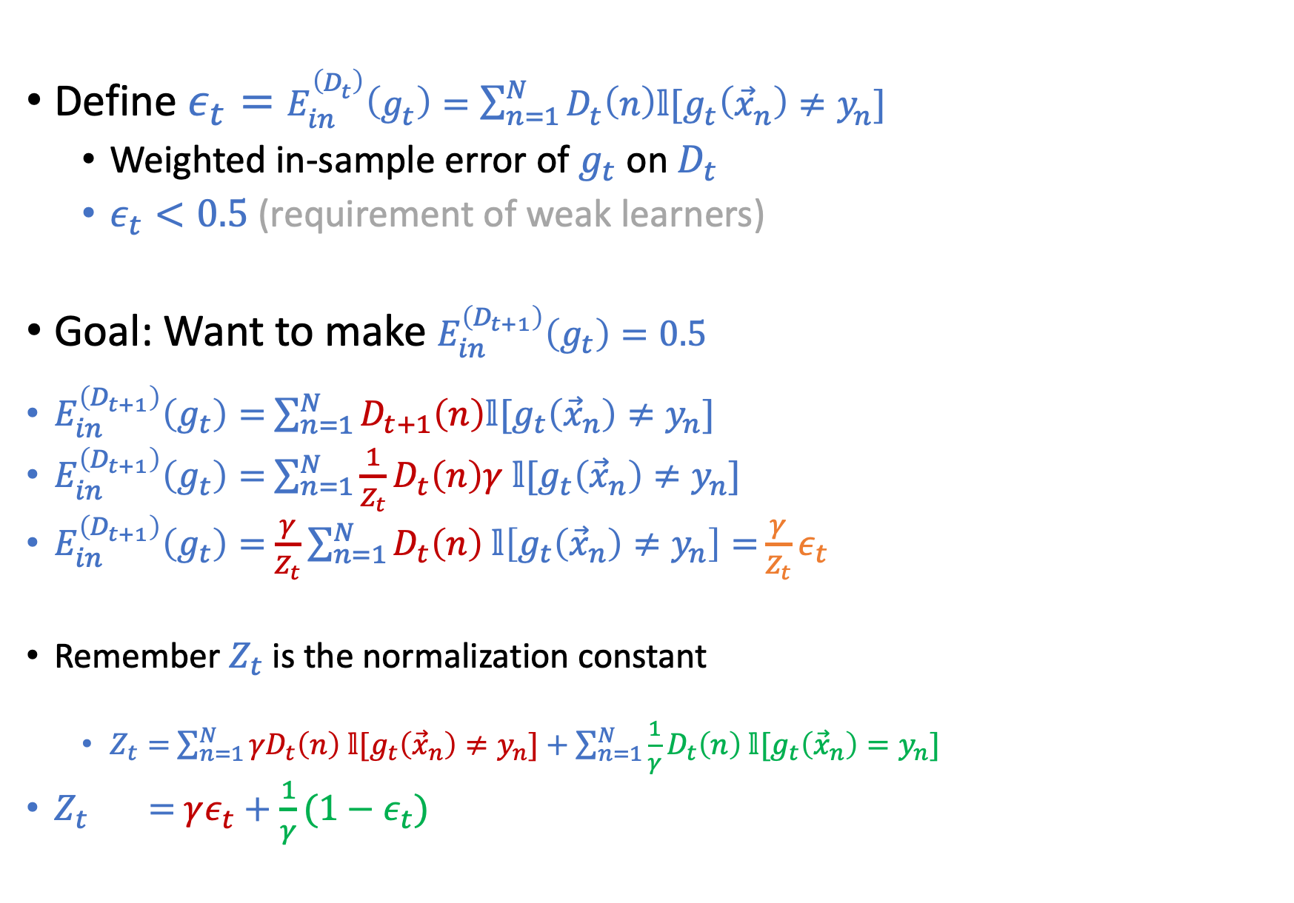
Define $ε_{t}=E_{in}^{\left(D_{t}\right)}\left(g_{t}\right)=\sum_{n=1}^{N}{D_{t}\left(n\right)𝕝[g_{t}\left({\vec{x}}_{n}\right)≠y_{n}]}$
Weighted in-sample error of $g_{t}$ on $D_{t}$
$ε_{t}<0.5$ (requirement of weak learners)
Goal: Want to make $E_{in}^{\left(D_{t+1}\right)}\left(g_{t}\right)=0.5$
$E_{in}^{\left(D_{t+1}\right)}\left(g_{t}\right)=$ $\sum_{n=1}^{N}{D_{t+1}\left(n\right)𝕝[g_{t}\left({\vec{x}}_{n}\right)≠y_{n}]}$
$E_{in}^{\left(D_{t+1}\right)}\left(g_{t}\right)=$ $\sum_{n=1}^{N}{{\frac{1}{Z_{t}}D}_{t}\left(n\right)γ 𝕝[g_{t}\left({\vec{x}}_{n}\right)≠y_{n}]}$
$E_{in}^{\left(D_{t+1}\right)}\left(g_{t}\right)=$ $\frac{γ}{Z_{t}}\sum_{n=1}^{N}{D_{t}\left(n\right) 𝕝\left[g_{t}\left({\vec{x}}_{n}\right)≠y_{n}\right]=}\frac{γ}{Z_{t}}ε_{t}$
Remember $Z_{t}$ is the normalization constant
$Z_{t}=$ $\sum_{n=1}^{N}{{γD}_{t}\left(n\right) 𝕝[g_{t}\left({\vec{x}}_{n}\right)≠y_{n}]}+\sum_{n=1}^{N}{\frac{1}{γ}D_{t}\left(n\right) 𝕝[g_{t}\left({\vec{x}}_{n}\right)=y_{n}]}$
$Z_{t} =$ $γε_{t}+\frac{1}{γ}(1−ε_{t})$
We consider the case weak learners are better than random guessing: $ε_{t}<0.5$
$$E_{in}^{\left(D_{t}\right)}(h)=\sum_{n=1}^{N}{D_{t}\left(n\right) \text{error}(h\left({\vec{x}}_{n}\right),y_{n})}$$

Slide 31
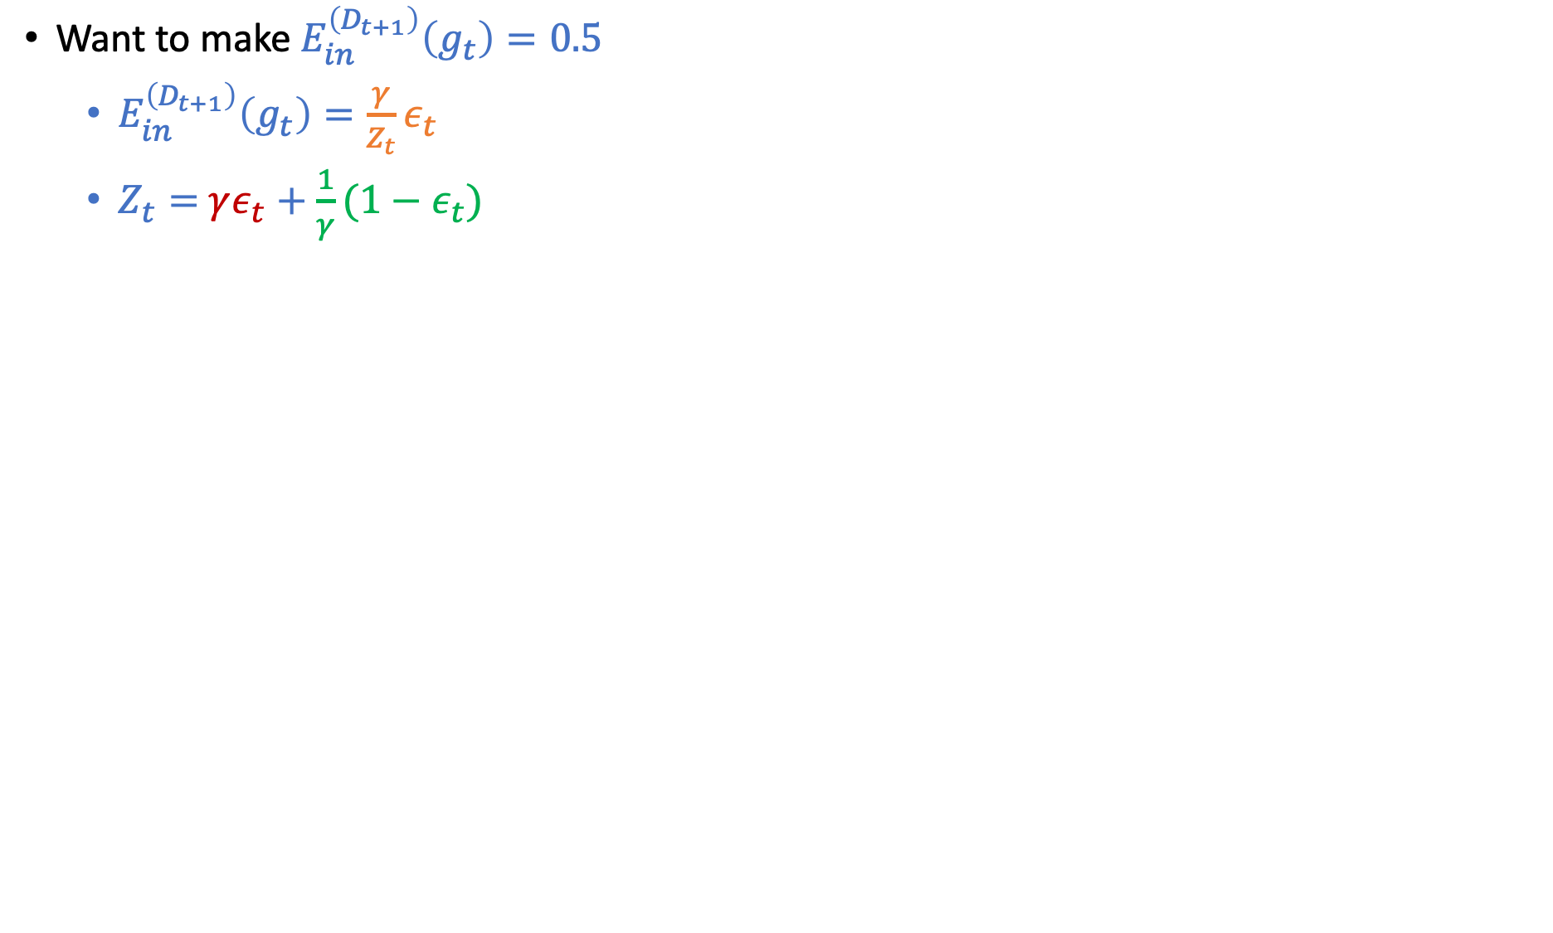
Want to make $E_{in}^{\left(D_{t+1}\right)}\left(g_{t}\right)=0.5$
$E_{in}^{\left(D_{t+1}\right)}\left(g_{t}\right)=\frac{γ}{Z_{t}}ε_{t}$
$Z_{t}=$ $γε_{t}+\frac{1}{γ}(1−ε_{t})$
$\frac{γε_{t}}{γε_{t}+(1−ε_{t})/γ}=0.5$ => $\frac{1−ε_{t}}{γ}=γε_{t}$=> $γ=\sqrt{\frac{1−ε_{t}}{ε_{t}}}$
Reweight rule
If $g_{t}\left({\vec{x}}_{n}\right)≠y_{n},$ then $D_{t+1}\left(n\right)=\frac{1}{Z_{t}}D_{t}\left(n\right){\left(\sqrt{\frac{1−ε_{t}}{ε_{t}}}\right)}^{}=$ $\frac{1}{Z_{t}}D_{t}\left(n\right){\left(\sqrt{\frac{1−ε_{t}}{ε_{t}}}\right)}^{g_{t}\left({\vec{x}}_{n}\right)y_{n}}$
If $g_{t}\left({\vec{x}}_{n}\right)=y_{n},$ then $D_{t+1}\left(n\right)=\frac{1}{Z_{t}}D_{t}\left(n\right){\left(\sqrt{\frac{1−ε_{t}}{ε_{t}}}\right)}^{−1}=\frac{1}{Z_{t}}D_{t}\left(n\right){\left(\sqrt{\frac{1−ε_{t}}{ε_{t}}}\right)}^{g_{t}\left({\vec{x}}_{n}\right)y_{n}}$
Note that both $g_{t}\left({\vec{x}}_{n}\right)$ and $y_{n}$ are either +1 or -1
If $g_{t}\left({\vec{x}}_{n}\right)≠y_{n}$, $g_{t}\left({\vec{x}}_{n}\right)y_{n}=−1$ ; If $g_{t}\left({\vec{x}}_{n}\right)=y_{n}$, $g_{t}\left({\vec{x}}_{n}\right)y_{n}=1$

Slide 32
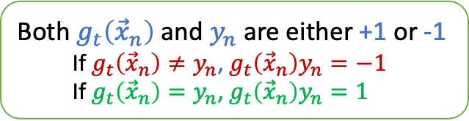
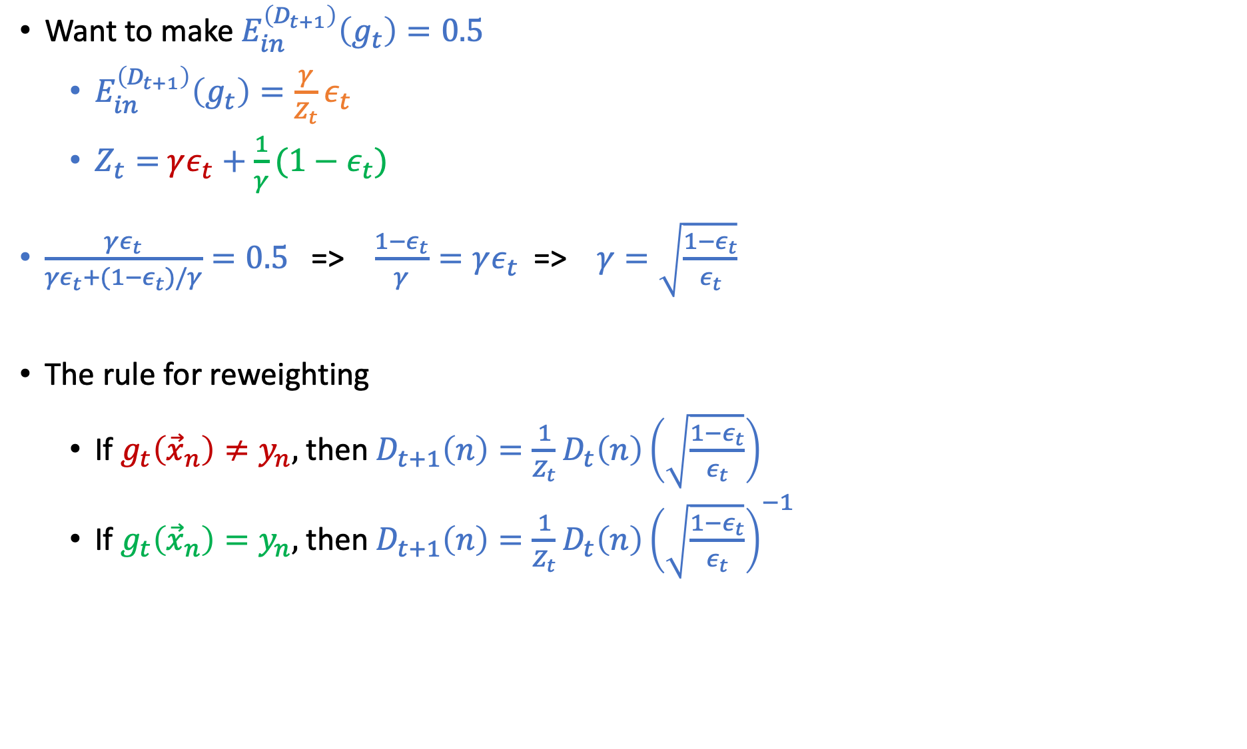
Want to make $E_{in}^{\left(D_{t+1}\right)}\left(g_{t}\right)=0.5$
$E_{in}^{\left(D_{t+1}\right)}\left(g_{t}\right)=\frac{γ}{Z_{t}}ε_{t}$
$Z_{t}=$ $γε_{t}+\frac{1}{γ}(1−ε_{t})$
$\frac{γε_{t}}{γε_{t}+(1−ε_{t})/γ}=0.5$ => $\frac{1−ε_{t}}{γ}=γε_{t}$=> $γ=\sqrt{\frac{1−ε_{t}}{ε_{t}}}$
The rule for reweighting
If $g_{t}\left({\vec{x}}_{n}\right)≠y_{n},$ then $D_{t+1}\left(n\right)=\frac{1}{Z_{t}}D_{t}\left(n\right){\left(\sqrt{\frac{1−ε_{t}}{ε_{t}}}\right)}^{}=$ $\frac{1}{Z_{t}}D_{t}\left(n\right){\left(\sqrt{\frac{1−ε_{t}}{ε_{t}}}\right)}^{g_{t}\left({\vec{x}}_{n}\right)y_{n}}$
If $g_{t}\left({\vec{x}}_{n}\right)=y_{n},$ then $D_{t+1}\left(n\right)=\frac{1}{Z_{t}}D_{t}\left(n\right){\left(\sqrt{\frac{1−ε_{t}}{ε_{t}}}\right)}^{−1}=\frac{1}{Z_{t}}D_{t}\left(n\right){\left(\sqrt{\frac{1−ε_{t}}{ε_{t}}}\right)}^{g_{t}\left({\vec{x}}_{n}\right)y_{n}}$
Both $g_{t}\left({\vec{x}}_{n}\right)$ and $y_{n}$ are either +1 or -1
If $g_{t}\left({\vec{x}}_{n}\right)≠y_{n}$, $g_{t}\left({\vec{x}}_{n}\right)y_{n}=−1$ If $g_{t}\left({\vec{x}}_{n}\right)=y_{n}$, $g_{t}\left({\vec{x}}_{n}\right)y_{n}=1$

Slide 33
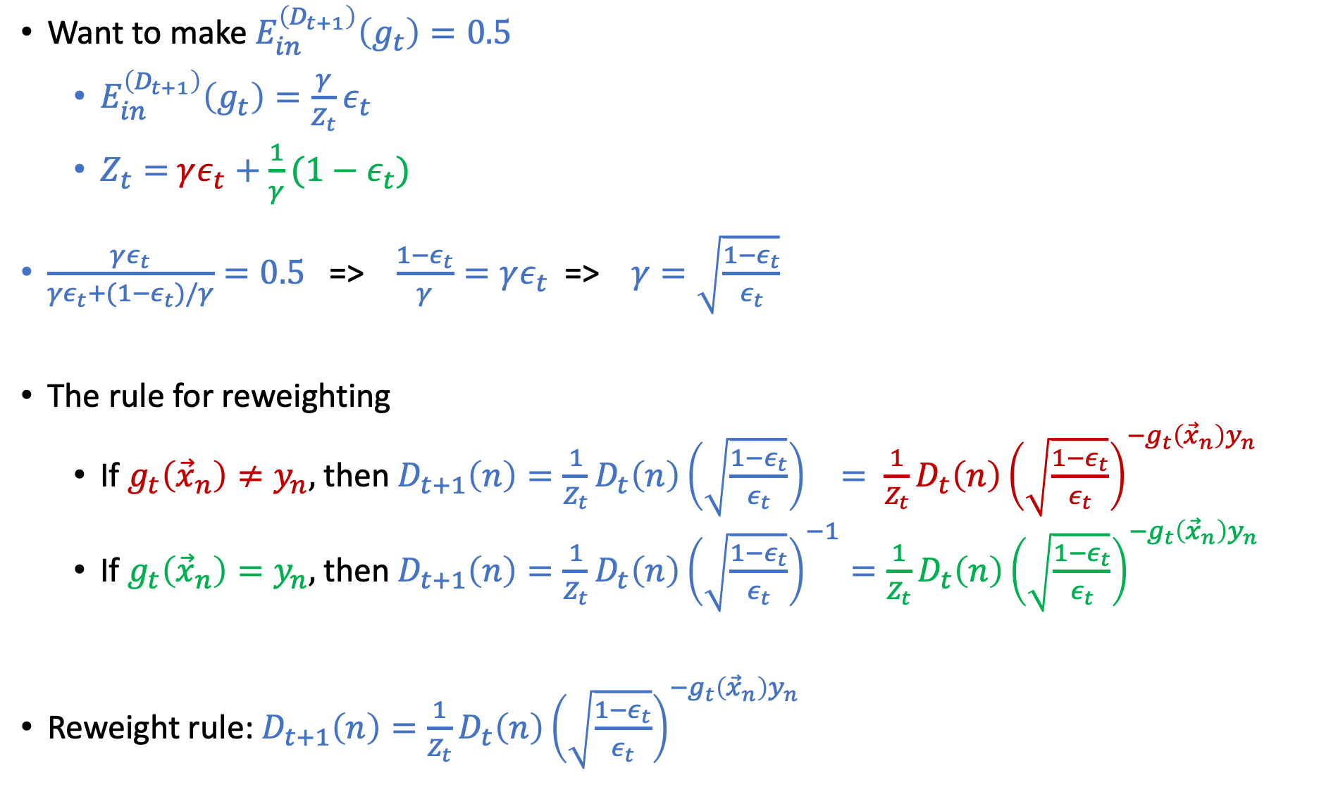
Want to make $E_{in}^{\left(D_{t+1}\right)}\left(g_{t}\right)=0.5$
$E_{in}^{\left(D_{t+1}\right)}\left(g_{t}\right)=\frac{γ}{Z_{t}}ε_{t}$
$Z_{t}=$ $γε_{t}+\frac{1}{γ}(1−ε_{t})$
$\frac{γε_{t}}{γε_{t}+(1−ε_{t})/γ}=0.5$ => $\frac{1−ε_{t}}{γ}=γε_{t}$=> $γ=\sqrt{\frac{1−ε_{t}}{ε_{t}}}$
The rule for reweighting
If $g_{t}\left({\vec{x}}_{n}\right)≠y_{n},$ then $D_{t+1}\left(n\right)=\frac{1}{Z_{t}}D_{t}\left(n\right){\left(\sqrt{\frac{1−ε_{t}}{ε_{t}}}\right)}^{}=$ $\frac{1}{Z_{t}}D_{t}\left(n\right){\left(\sqrt{\frac{1−ε_{t}}{ε_{t}}}\right)}^{{−g}_{t}\left({\vec{x}}_{n}\right)y_{n}}$
If $g_{t}\left({\vec{x}}_{n}\right)=y_{n},$ then $D_{t+1}\left(n\right)=\frac{1}{Z_{t}}D_{t}\left(n\right){\left(\sqrt{\frac{1−ε_{t}}{ε_{t}}}\right)}^{−1}=\frac{1}{Z_{t}}D_{t}\left(n\right){\left(\sqrt{\frac{1−ε_{t}}{ε_{t}}}\right)}^{{−g}_{t}\left({\vec{x}}_{n}\right)y_{n}}$
Reweight rule: $D_{t+1}\left(n\right)=\frac{1}{Z_{t}}D_{t}\left(n\right){\left(\sqrt{\frac{1−ε_{t}}{ε_{t}}}\right)}^{{−g}_{t}\left({\vec{x}}_{n}\right)y_{n}}$

Slide 34
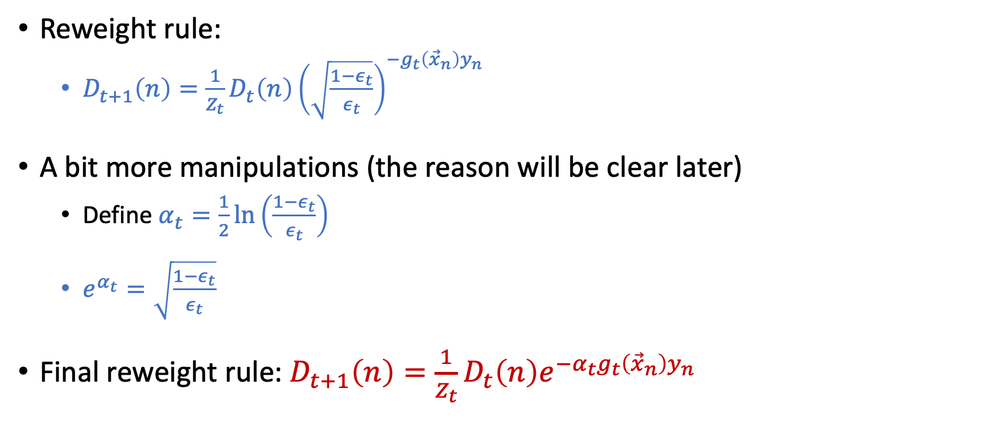
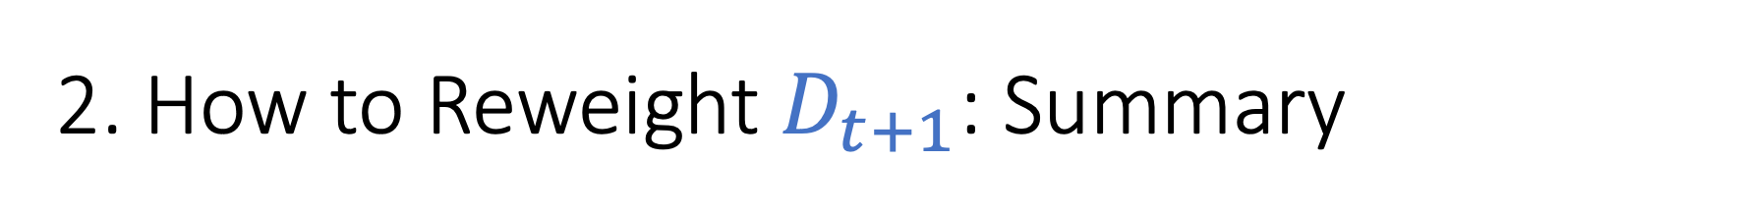
2. How to Reweight $D_{t+1}$: Summary
Reweight rule:
$D_{t+1}\left(n\right)=\frac{1}{Z_{t}}D_{t}\left(n\right){\left(\sqrt{\frac{1−ε_{t}}{ε_{t}}}\right)}^{{−g}_{t}\left({\vec{x}}_{n}\right)y_{n}}$
A bit more manipulations (the reason will be clear later)
Define $α_{t}=\frac{1}{2}\ln\left(\frac{1−ε_{t}}{ε_{t}}\right)$
$e^{α_{t}}=\sqrt{\frac{1−ε_{t}}{ε_{t}}}$
Final reweight rule: $D_{t+1}\left(n\right)=\frac{1}{Z_{t}}D_{t}\left(n\right)e^{{−α_{t}g}_{t}\left({\vec{x}}_{n}\right)y_{n}}$

Slide 35
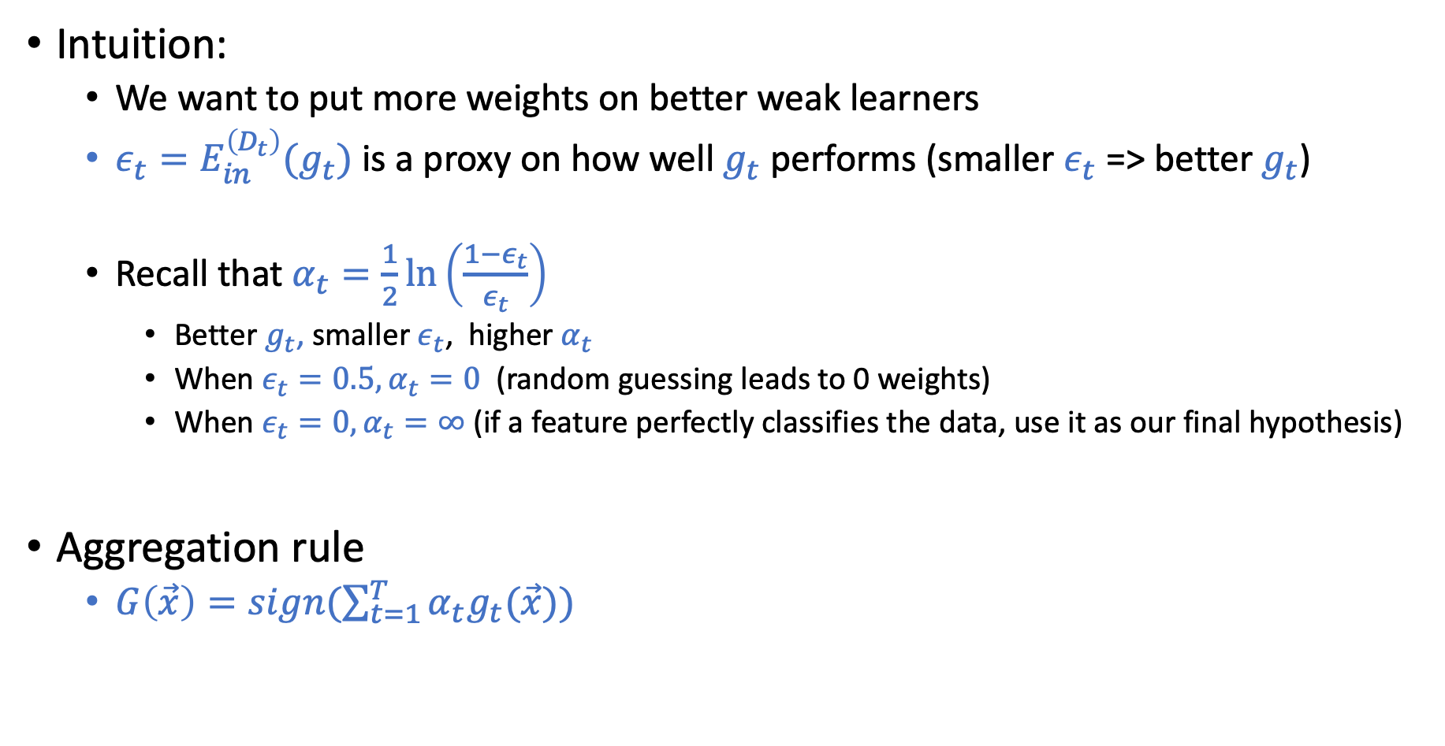
3. How to Aggregate Weak Learners
Intuition:
We want to put more weights on better weak learners
$ε_{t}=E_{in}^{\left(D_{t}\right)}(g_{t})$ is a proxy on how well $g_{t}$ performs (smaller $ε_{t}$ => better $g_{t}$)
Recall that $α_{t}=\frac{1}{2}\ln\left(\frac{1−ε_{t}}{ε_{t}}\right)$
Better $g_{t}$, smaller $ε_{t}$, higher $α_{t}$
When $ε_{t}=0.5, α_{t}=0$ (random guessing leads to 0 weights)
When $ε_{t}=0, α_{t}=∞$ (if a feature perfectly classifies the data, use it as our final hypothesis)
Aggregation rule
$G\left(\vec{x}\right)=sign(\sum_{t=1}^{T}{α_{t}g_{t}(\vec{x})})$

Slide 36
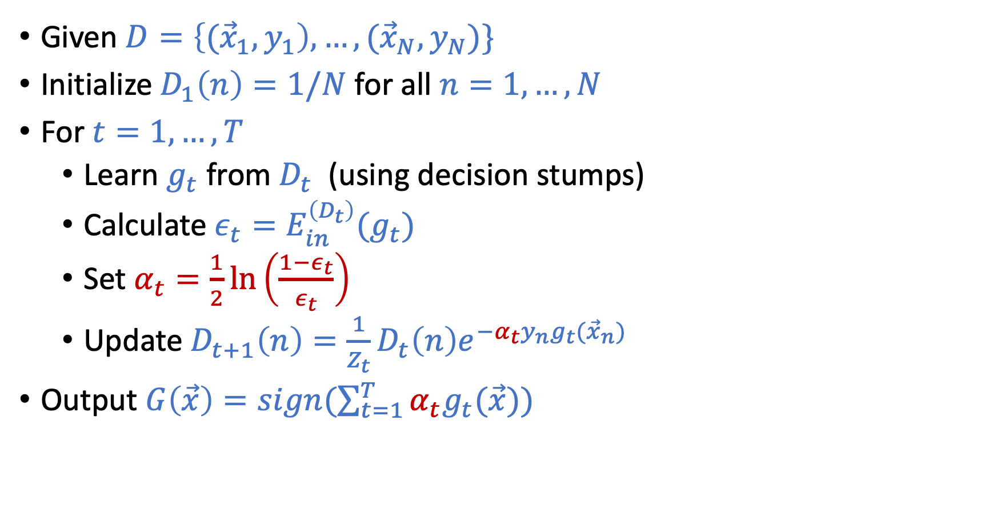
AdaBoost Algorithm
Given $D=\left\{{(\vec{x}}_{1},y_{1}\right),…,({\vec{x}}_{N},y_{N})\}$
Initialize $D_{1}\left(n\right)=1/N$ for all $n=1,…,N$
For $t=1,…,T$
Learn $g_{t}$ from $D_{t}$ (using decision stumps)
Calculate $ε_{t}=E_{in}^{\left(D_{t}\right)}(g_{t})$
Set $α_{t}=\frac{1}{2}\ln\left(\frac{1−ε_{t}}{ε_{t}}\right)$
Update $D_{t+1}\left(n\right)=\frac{1}{Z_{t}}D_{t}\left(n\right)e^{−α_{t}y_{n}g_{t}({\vec{x}}_{n})}$
Output $G\left(\vec{x}\right)=sign(\sum_{t=1}^{T}{α_{t}g_{t}(\vec{x})})$

Slide 37
Short Break and Questions Answering

Slide 38
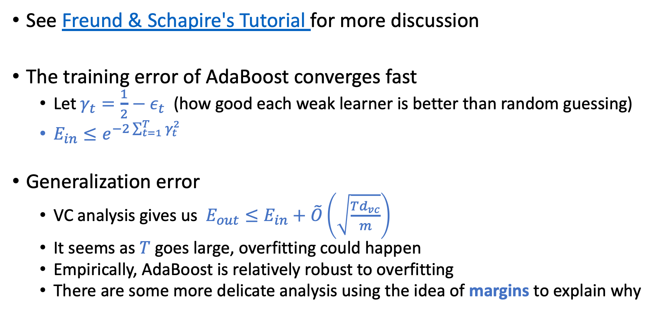
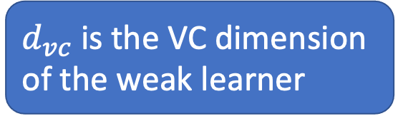
Theoretical Properties of AdaBoost
See Freund & Schapire's Tutorial for more discussion
The training error of AdaBoost converges fast
Let $γ_{t}=\frac{1}{2}−ε_{t}$ (how good each weak learner is better than random guessing)
$E_{in}≤e^{−2\sum_{t=1}^{T}{γ_{t}^{2}}}$
Generalization error
VC analysis gives us $E_{out}≤E_{in}+\tilde{O}\left(\sqrt{\frac{Td_{vc}}{m}}\right)$
It seems as $T$ goes large, overfitting could happen
Empirically, AdaBoost is relatively robust to overfitting
There are some more delicate analysis using the idea of margins to explain why
$d_{vc}$ is the VC dimension of the weak learner

Slide 39
AdaBoost in Action

Slide 40
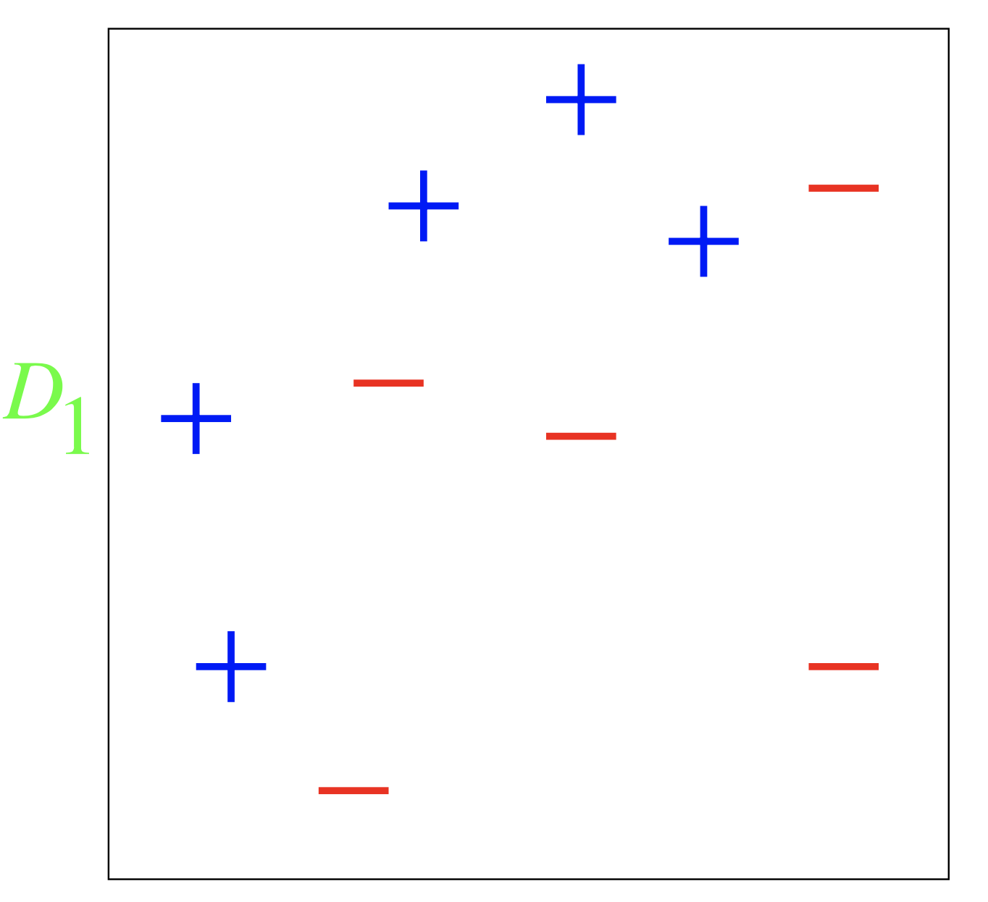
AdaBoost in Action
A toy example (by Yoav Freund Rob Schapire)
Weak learner: decision stump (one-level decision tree)

Slide 41
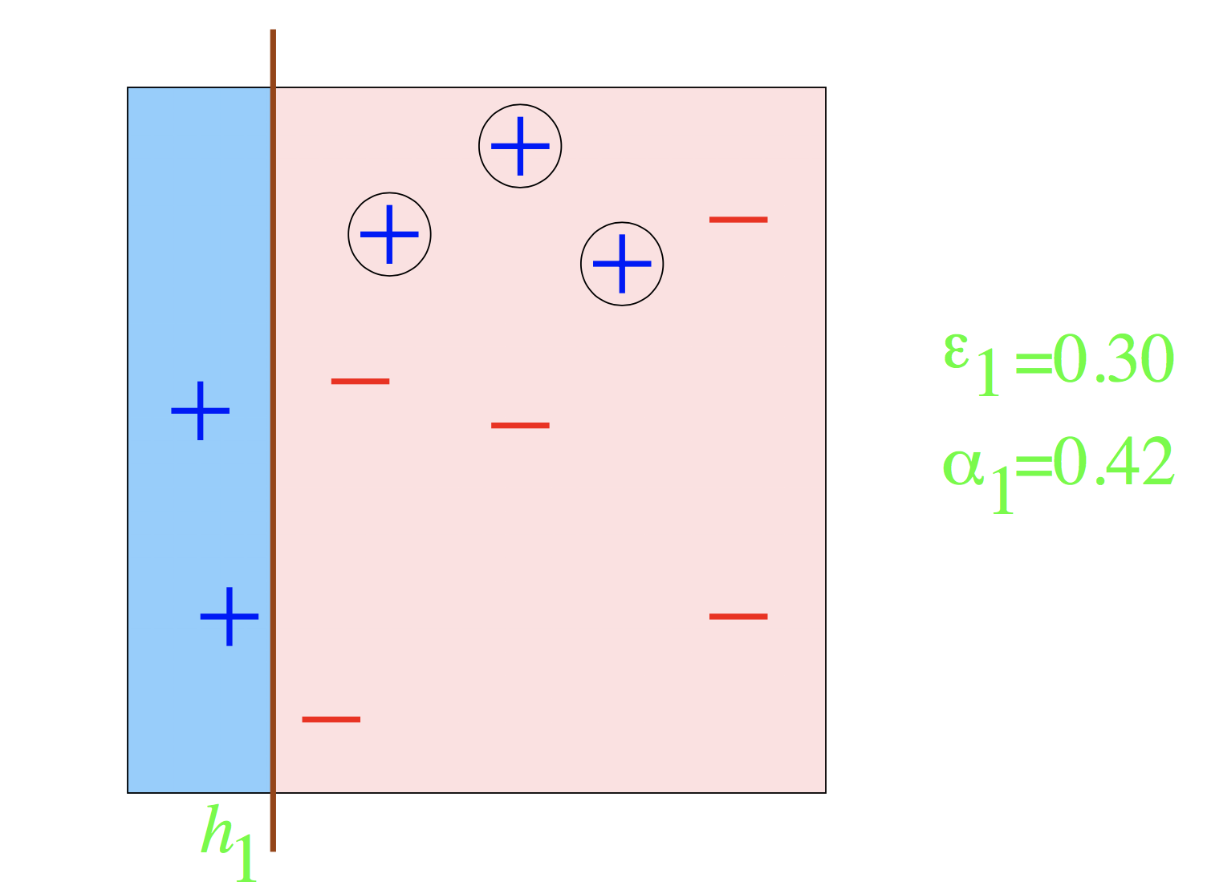
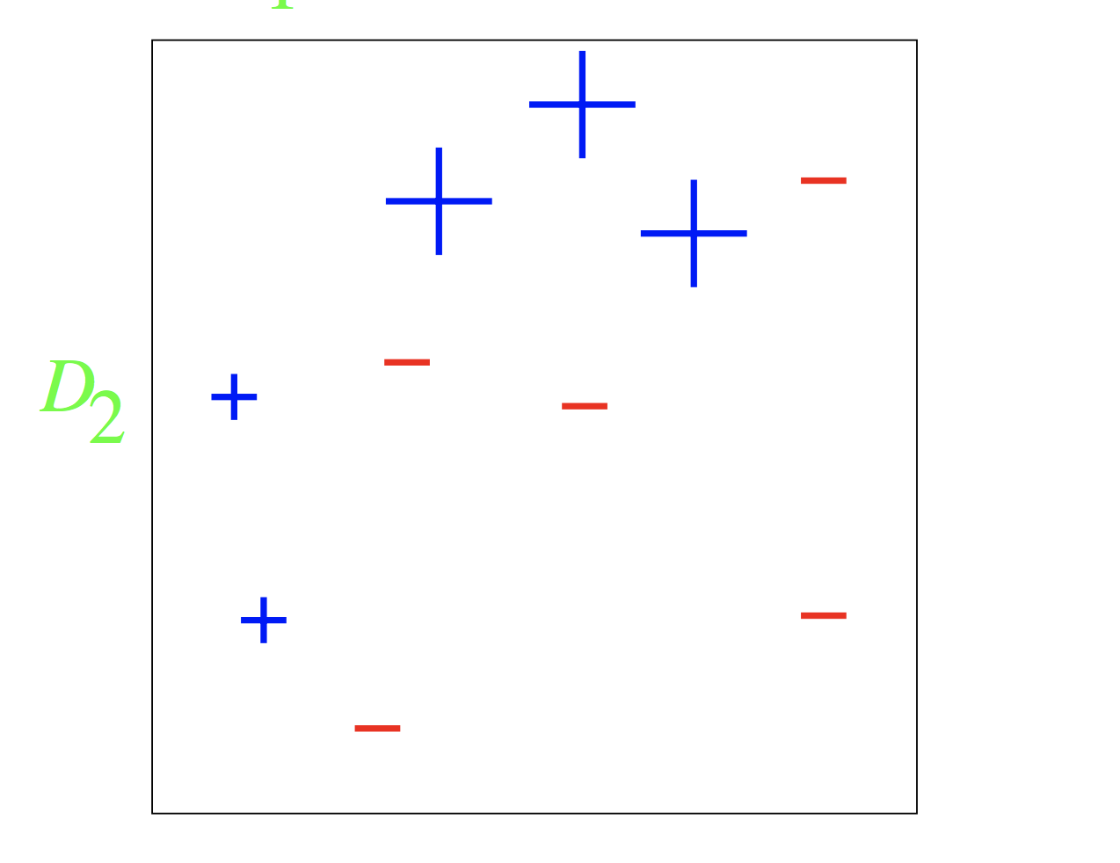
Round 1

Slide 42


Round 2

Slide 43

Round 3

Slide 44



Slide 45
Practical Success of AdaBoost

Slide 46


Viola-Jones Face Detection (2001)
First real-time object detection framework
Paul Viola and Michael Jones. Rapid object detection using a boosted cascade of simple features. CVPR 2001.

Slide 47


Weak Learners (Haar wavelet features)

Slide 48
Weak Learners (Haar wavelet features)
Each hypothesis is very weak.
There are many possible features.
For a 24x24 detection region, more then 160,000 features
AdaBoost!
Training is slow
Testing is fast
(inherent feature selection)

Slide 49
Brief Discussion on Gradient Boosting
Gradient boosting is safe to skip for Exam 2

Slide 50



Look at the AdaBoost Algorithm Again
Given $D=\left\{{(\vec{x}}_{1},y_{1}\right),…,({\vec{x}}_{N},y_{N})\}$
Initialize $D_{1}\left(n\right)=1/N$ for all $n=1,…,N$
For $t=1,…,T$
Learn $g_{t}$ from $D_{t}$ (using decision stumps)
Calculate $ε_{t}=E_{in}^{\left(D_{t}\right)}(g_{t})$
Set $α_{t}=\frac{1}{2}\ln\left(\frac{1−ε_{t}}{ε_{t}}\right)$
Update $D_{t+1}\left(n\right)=\frac{1}{Z_{t}}D_{t}\left(n\right)e^{−α_{t}y_{n}g_{t}({\vec{x}}_{n})}$
Output $G\left(\vec{x}\right)=sign(\sum_{t=1}^{T}{α_{t}g_{t}(\vec{x})})$
Initialize $G\left(\vec{x}\right)=0$
For $t=1,…,T$
$$G\left(\vec{x}\right)←G\left(\vec{x}\right)+α_{t}g_{T}(\vec{x})$$
Output $sign(G(\vec{x}))$
The format is similar to gradient descent!
If we consider the space of the weak learners (i.e., $g_{t}(\vec{x})$) as the space of “weights”
This observation leads to a general class of boosting algorithms: gradient boosting
XGBoost is one implementation of gradient boosting that is popular in practice
See CASI 17.4 and the reference in CASI P.350 for more discussion
[Safe to Skip]

Slide 51




Gradient Boosting
Initialize $G\left(\vec{x}\right)=0$
For $t=1,…,T$
$$G\left(\vec{x}\right)←G\left(\vec{x}\right)+α_{t}g_{T}\left(\vec{x}\right)$$
Output $sign(G(\vec{x}))$
AdaBoost is a special case of Gradient Boosting
minimizing the exponential loss ($e_{exp}\left(h\left(\vec{x}\right),y\right)=e^{−yh(\vec{x})}$)
using decision stump as the weak learners
$$f\left(x\right)=+1$$
$e_{exp}$ is a surrogate loss function of the binary classification error we care about
Minimizing an alternative error (loss function) is a common trick in ML, especially when the target loss function is hard to optimize.
There are some theoretical discussions on when doing this makes sense (“calibration”: whether minimizing the surrogate is consistent with minimizing the original loss).
[Safe to Skip]

